Slide 1
Analysis of Transmission Line Discontinuities using Time Domain Reflectometry
05/02/2024
Ankit Kumar
Shrinithi Venkatesan

Slide 2
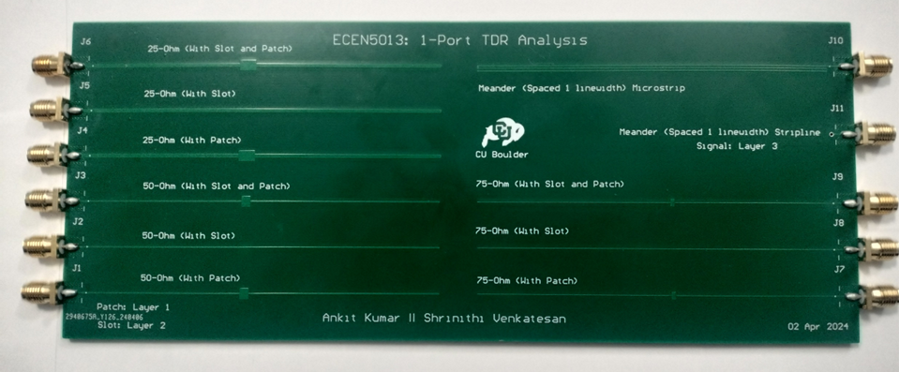
AGENDA
Background
Project Flow
Transmission Line Simulation with Discontinuities
1 Port Measurement on PCB
Measured TDR Plots
Hacked TDR Plots
Observations

Slide 3
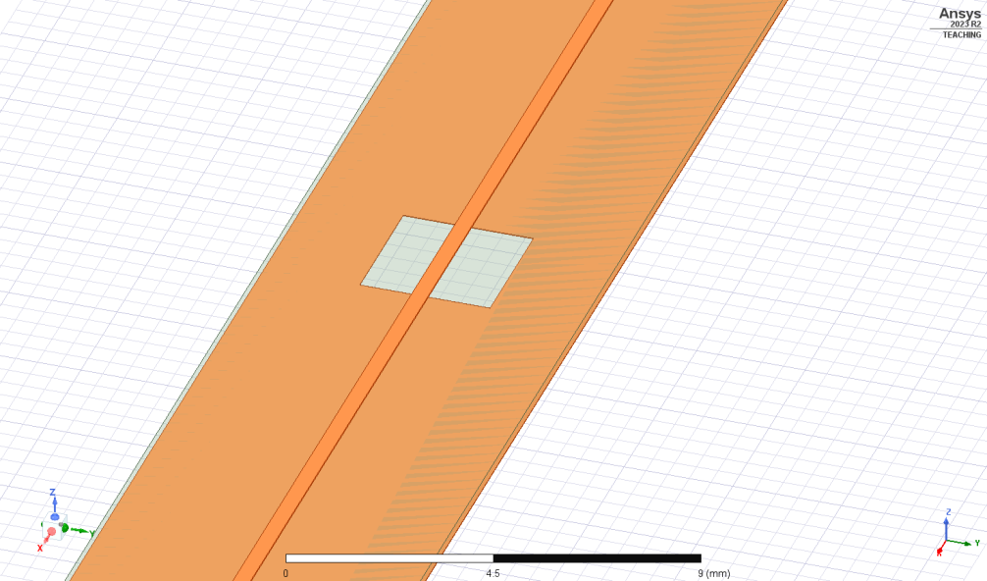
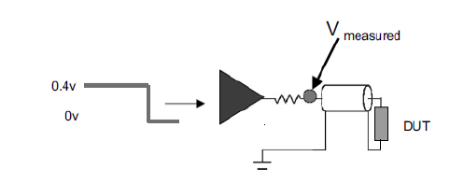
Key Definitions:
Return Path Discontinuity (RPD):
Path of the returning conduction current of an interconnect is “discontinuous”.
Causes the return-current to continue as displacement current, to close the loop.
TDR Internal Schematic.
Capacitance and inductance Discontinuity.
Discontinuity in Return Path
Analyze -> Time Domain Reflectometry (TDR)

Slide 4



Design Flow and Project Goals:
Simulation
Board Design
TDR Measurements
Takeaways
Hacking in ADS
Result analysis
Simulate Transmission Lines 25/50/75 Ω
Obtain Design Parameters
Design PCB using parameters from Simulation for Transmission Lines 25/50/75 Ω
Obtain 1-Port Measurements
Import s1p files, plot and analyse the TDR for Measured Data
Reverse Engineer and plot the TDR for Simulated Data
Compare the plots for Measured and Simulated Data.
Verify the best design and measurement practices.

Slide 5
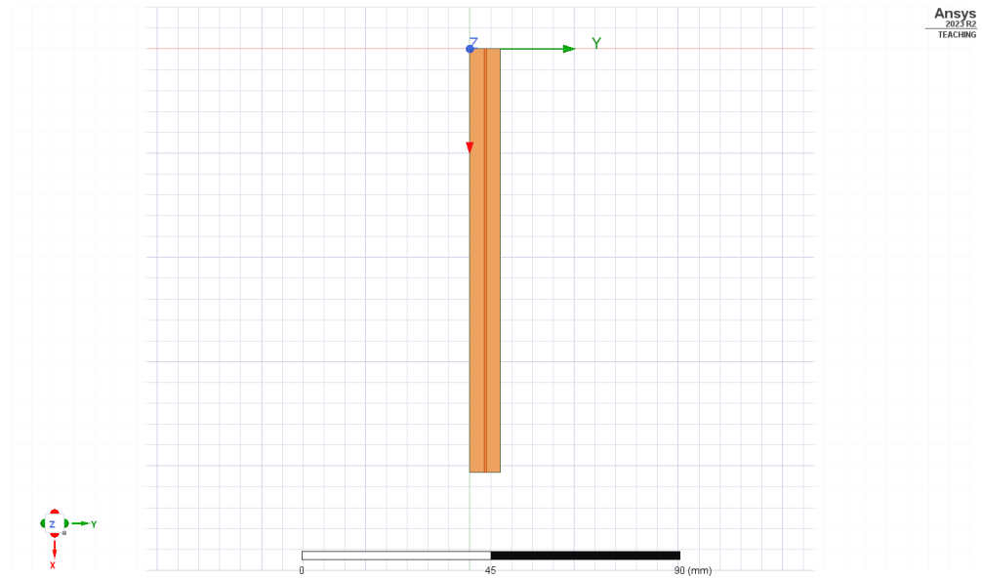
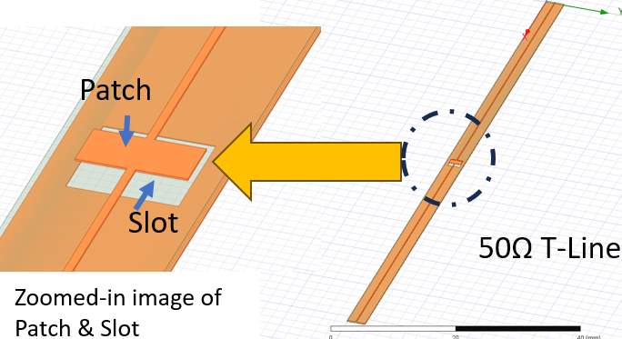
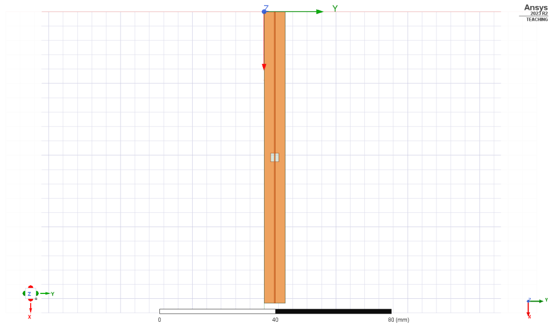
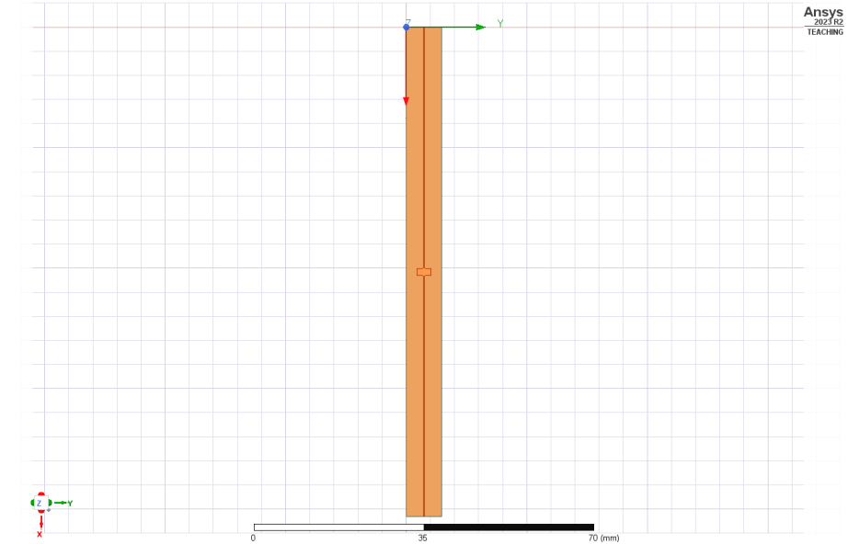
Simulation setup in HFSS
Slot + Patch (Compensated to 50 Ω)
Microstrip T-Line 50 Ω
Slot in return plane
The Design Properties for Slot and Patch
Patch in signal plane

Slide 6
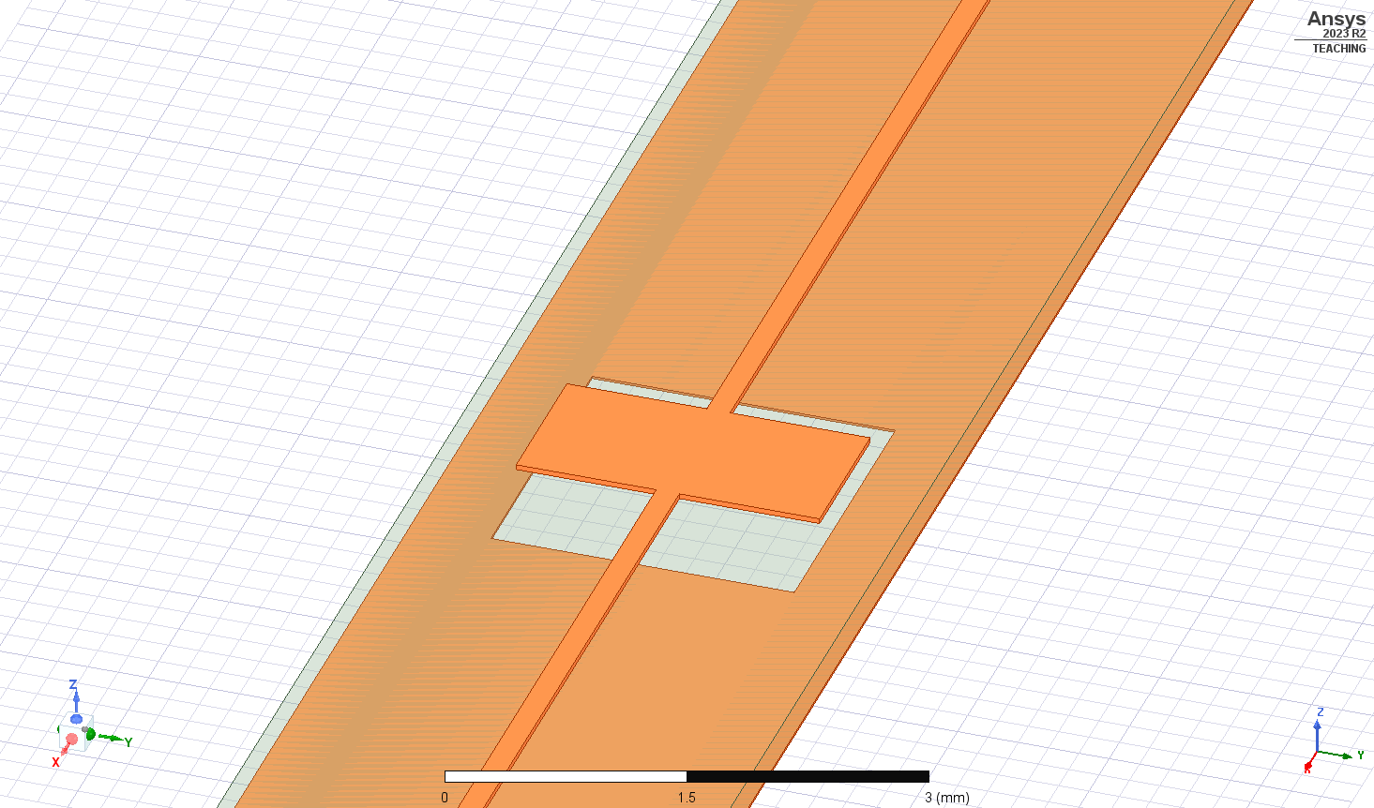
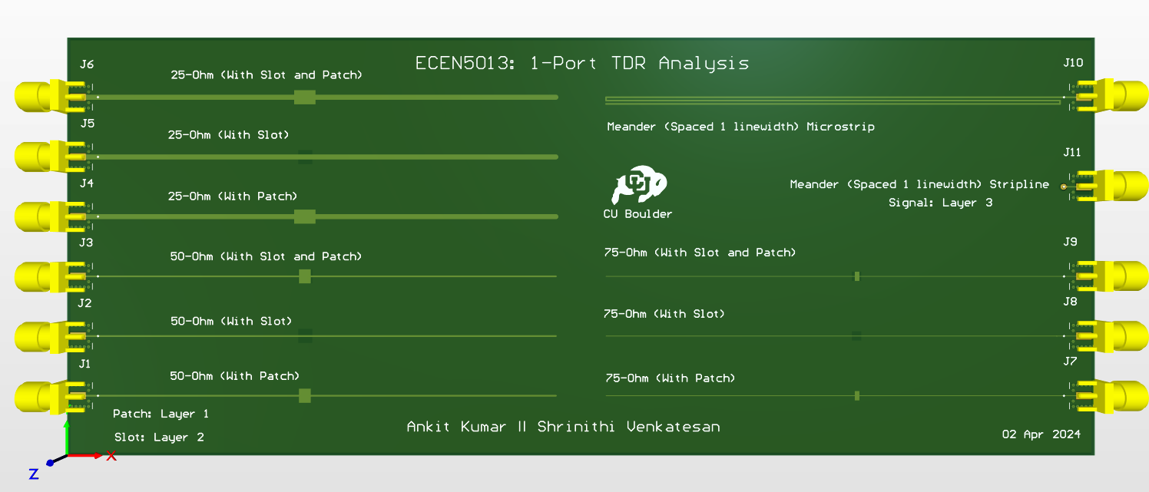
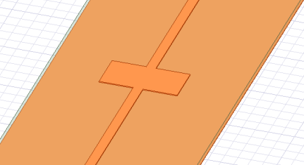
Board Setup:
Discontinuities
Microstrip T-Line
Board Design
Capacitive + Inductive discontinuity Patch + Slot
Inductive discontinuity Slot
Capacitive discontinuity Patch

Slide 7
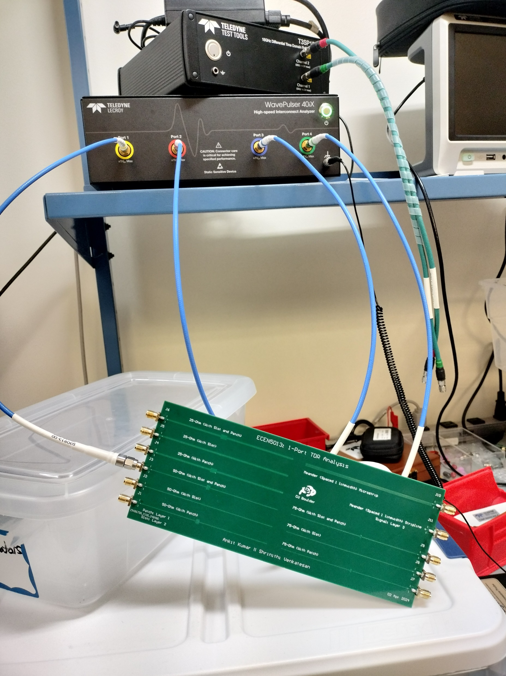
1-Port VNA Measurements:
Plan of Record for the Measurement:
1-Port VNA measurement.
Obtained s1p files.
Export to Keysight ADS.

Slide 8
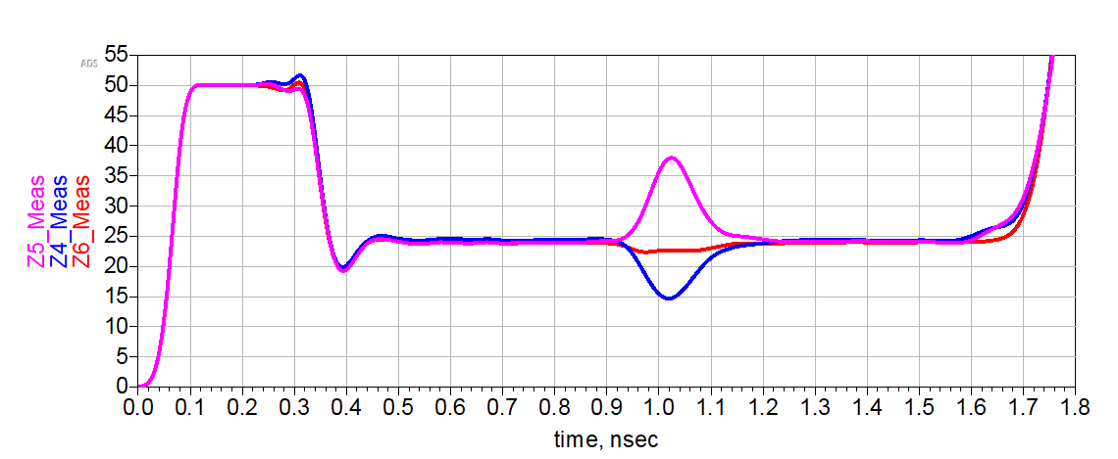
Measured TDR Analysis in Keysight ADS (25Ω)
TDR Plot for 25Ω T-Line
10/90 Rise time[50ps]
T LIND = 50Ω
~ 37.5Ω
Inductive Discontinuity [Slot]
Zo = 25Ω
~ 24Ω
Capacitive and Inductive Discontinuity [Patch and Slot]
Launch Discontinuity
~ 15Ω
Capacitive Discontinuity [Patch]

Slide 9
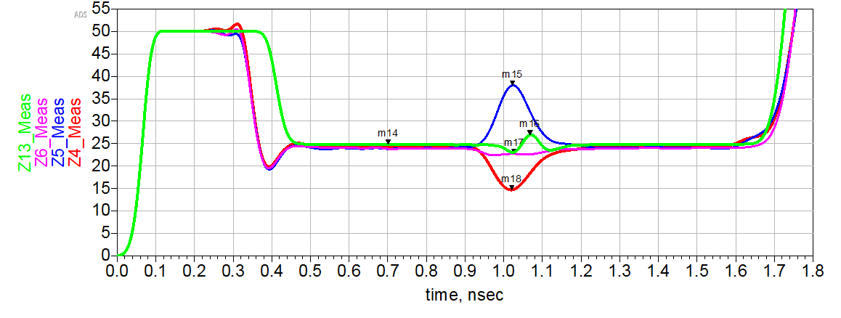
Comparison of the Measured Vs. Simulated values for 25Ω Transmission Line:
TDR Plot for 25Ω T-Line
Maximum Discontinuity in case of compensated (Slot & Patch) is reduced to as low as ~8%
Measured Results (Zo = 24.7Ω):
Plot | Error % (wrt Measured)
Patch | -40.6%
Slot | 53.7%
Patch & Slot | -7.9%
37.98Ω
Measured [Slot]
Zo = 24.8Ω
Simulated [Patch & Slot] 25Ω
Zo = 24.7Ω
22.73Ω
Measured [Patch & Slot]
14.67Ω
Measured [Patch]
Simulated Results (Zo = 24.8Ω):
Error = 0.4%

Slide 10
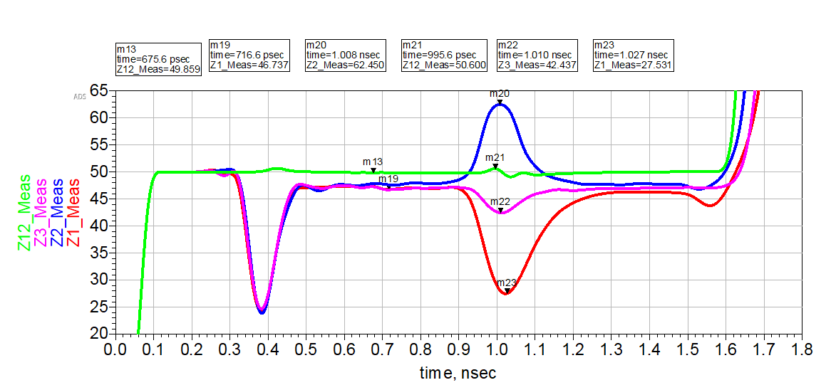
Comparison of the Measured Vs. Simulated values for 50Ω Transmission Line:
TDR Plot for 50Ω T-Line
Maximum Discontinuity in case of compensated (Slot & Patch) is reduced to as low as ~9%
62.4Ω
Measured Results (Zo = 46.8Ω):
Measured [Slot]
Zo = 49.9Ω
Simulated [Patch & Slot]
Plot | Error % (wrt Measured)
Patch | -41.1%
Slot | 33.3%
Patch & Slot | -9.3%
50.6Ω
Zo = 46.8Ω
42.43Ω
Measured [Patch & Slot]
27.53Ω
Simulated Results (Zo = 49.9Ω):
Measured [Patch]
Error = 6.2%

Slide 11
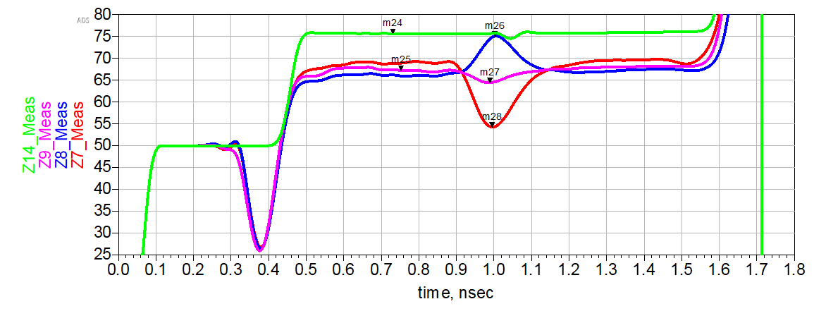
Comparison of the Measured Vs. Simulated values for 75Ω Transmission Line:
TDR Plot for 75Ω T-Line
Maximum Discontinuity in case of compensated (Slot & Patch) is reduced to as low as ~4.5%
Simulated [Patch & Slot]
75.13 Ω
Zo = 75.6Ω
Measured Results (Zo = 46.8Ω):
75.13Ω
Measured [Slot]
Plot | Error % (wrt Measured)
Patch | -19.6%
Slot | 11.3%
Patch & Slot | -4.5%
Zo = 67.5Ω
64.45Ω
Measured [Patch & Slot]
54.27Ω
Measured [Patch]
Simulated Results (Zo = 49.9Ω):
Error = 12%

Slide 12
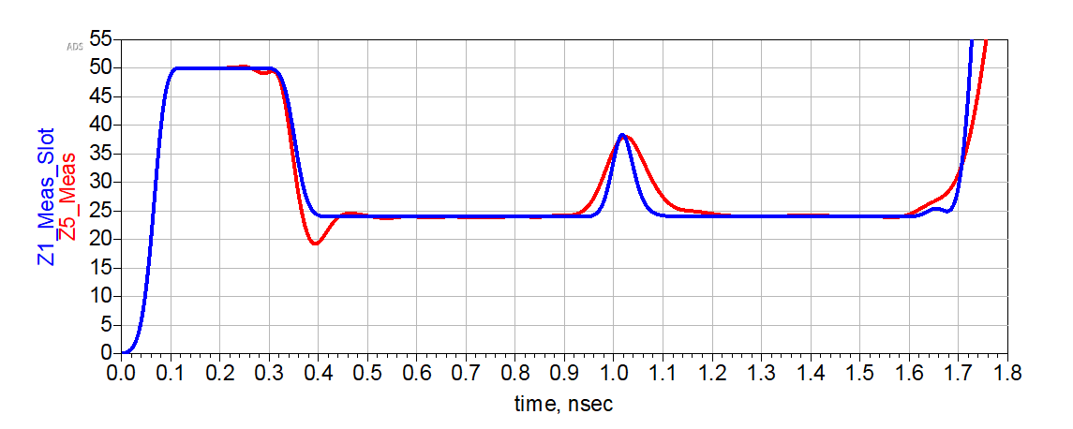
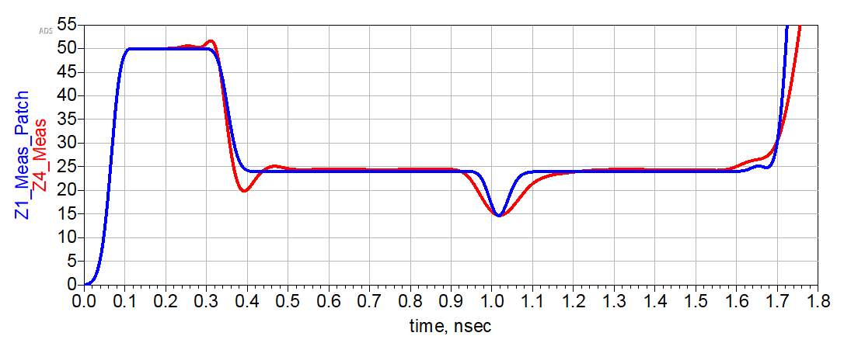
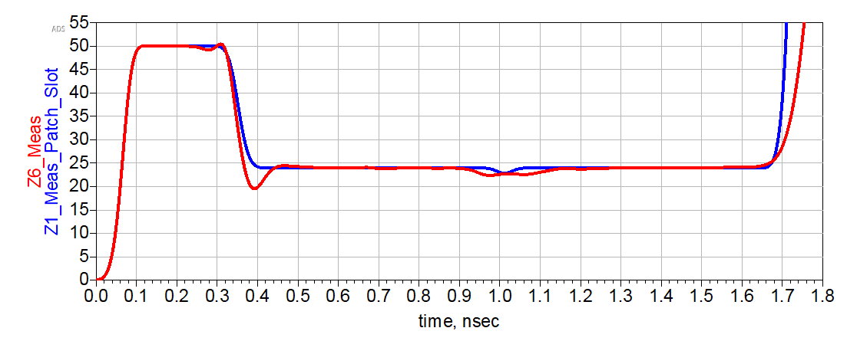
Reverse Engineering the Design (25Ω)
Inductive Discontinuity [Slot]
Capacitive Discontinuity [Patch]
- Simulated
- Measured
- Simulated
- Measured
Inductive & Capacitive Discontinuity [Patch & Slot]
Estimated values of Capacitance and Inductance present in the slot and patch
- Simulated
- Measured
Plot | C (pF) | L (nH)
Patch | 1.05 | -
Slot | - | 0.7
Patch & Slot | 0.27 | 0.1

Slide 13
Key Takeaways:
Slot -> Increase in inductance, elevates the impedance value -> peak.
Patch -> Enlarges the trace area, increase in capacitance -> dip.
Control the geometries of the slot and the patch -> control the characteristics impedance of the transmission line.
Best Design Practice:
If allowed, Always use uniform, wide and continuous return path because:
“Return current is as important as signal current.”
13

Slide 14

Thank You!
Questions Please?

